Slide 1

Project Title -
Global Debt and Credit Risk Analysis
Subham Mandal

Slide 2

PROBLEM STATEMENT
Understanding the global distribution of debt and credit.
Analyzing risk levels associated with different countries debt.

Slide 3
Project Description This project analyzes the debt and credit relationships between countries using Power BI. The dataset includes creditor and debtor countries, the amount of debt, and associated risk levels. Visualizations are created to provide insights into global debt distribution and risk analysis.

Slide 4

WHO ARE THE END USERS?
The potential end users of My project are:-
Financial analysts
Economists
Policy makers
International investors

Slide 5

Technology Used
The technologies I used.
Microsoft Power BI
CSV data processing
Data visualization techniques

Slide 6
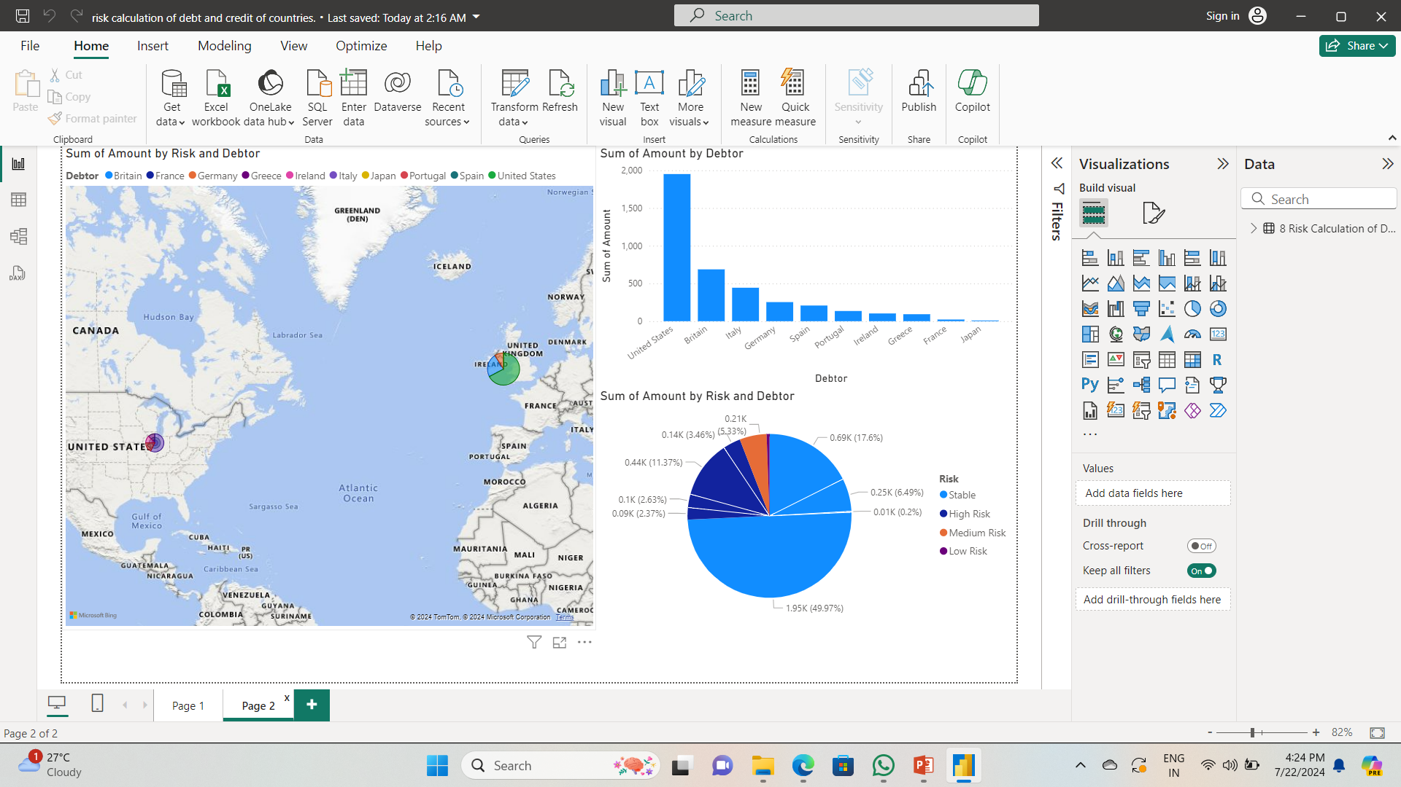
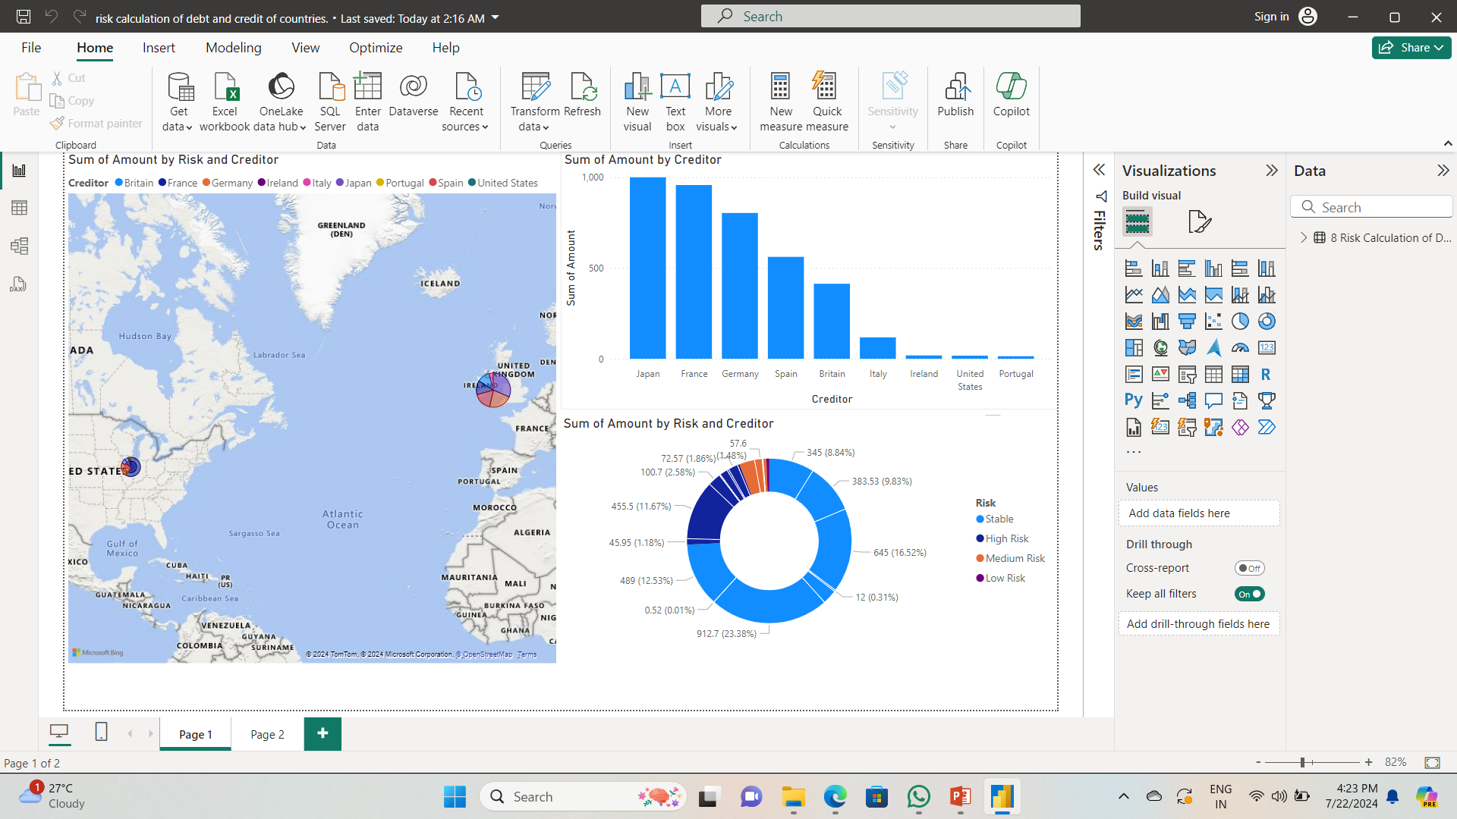
RESULTS
A Total Debt by Creditor Country
Total Debt by Debtor Country
Distribution of Debt Risk Levels
Geographical Distribution of Total Debt by Creditor Country
Demo Lhttps://drive.google.com/file/d/1wtCRELj0UTvAldP-AuQ26XJz62s89v0_/view?usp=sharingink

Slide 7
Thank you
.
.

